Slide 1
Distributed Data Processing
Tseng-Ching James Shen, PhD

Slide 2
Agenda
Motives
Data Sharding
Distributed Job Processing
Data Availability

Slide 3
Motives
Let’s assume you want to write a program to traverse a large array of records on disk and apply a logic (say multiply by 5) to each element
Execution time = Tp X N (what is Tp?)
Options to introduce parallelism to improve the execution time
Multiple threading
Graphic Processing Unit (GPU)
Multi-processes running on multiple processors

Slide 4
Multi-threading
Multiple threads can be started in parallel, and each thread can run on one CPU core to process part of the workload
Performance is limited by the number of cores available on the processor
Vertical Scaling is to add resources (# of CPUs, # of CPU cores, RAM) to support more threads running concurrently
Vertical scaling might require custom design, so it is not cost effective

Slide 5
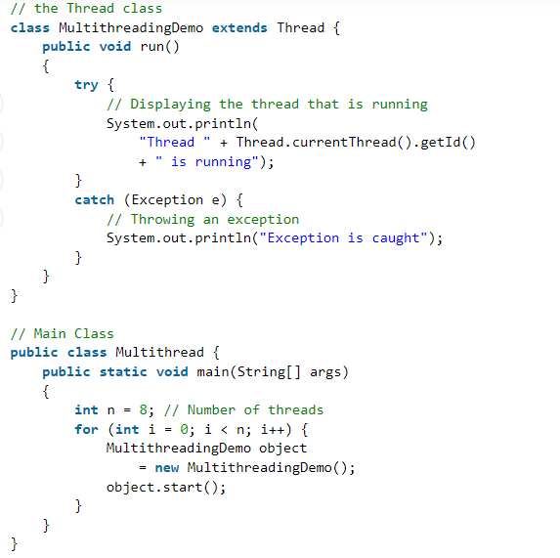

Slide 6
Graphic Processing Unit (GPU)
Specialized hardware which can perform the same operation on an array of objects in parallel (SIMD processing)
Programs need to be develped in ‘parallel’ fashion and compiled into machine code which will take advantage of the specialized hardware.
GPU was originally introduced for displaying graphics of games applications
GPU is heavily used in Deep Learning nowadays to train neural networks with large number of neuros

Slide 7
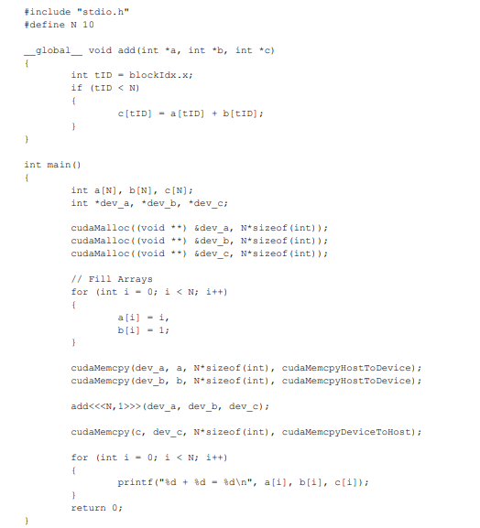

Slide 8
Multi-Process Running on Multi-Processor
Multiple processes can be run in parallel, and each process running on one processor can process the data located on the processor
Processors are built with commodity hardware
Performance is limited by the number of processors
Limitation can be removed with Horizontal Scaling which adds more processors to process the workload
Cost effective
Focus of this course

Slide 9
Issues of Multi-Processor Approach
How can partitioned data be managed?
What data each server should store?
How does an application know where to find data?
➔Data Sharding
How can concurrently running processes be managed?
How to remotely start a process on a server?
How to keep track of the status of a running process?
How to manage resources in a cluster?
➔Distributed Job Processing

Slide 10
Data Sharding
Data partitioned into groups (Shards) and stored on different machines
Data can be processed concurrently on different machines
Speed up the processing time by the number of shards (ideally)
Examples
Hadoop Distributed File System
NoSQL DBMS

Slide 11
Data Sharding (Cont.)
Data Coordinator
Client App.
Data Catalog
Network
Shard Mgr
Shard Mgr
Shard Mgr
Shard 1
Shard i
Shard n

Slide 12
Insert Data
The client communicates with Data Coordinator to find out which Shard the data should be inserted into
The Data Coordinator consults its Data Catalog to determine the Shard
The Data Coordinator sends it back to the client
The client work with the designated Shard manager to insert the data

Slide 13
Retrieve Data
The client communicates with Data Coordinator to find out which Shard the data resides in
The Data Coordinator consults its Data Catalog to determine the Shard
The Data Coordinator sends back the Shard number to the client
The client work with the designated Shard manager to retrieve the data

Slide 14
Distributed Job
Distributed algorithms defines a set of collaborative tasks (ie processes) which run concurrently to process data on a cluster of machines
Hadoop MapReduce programming model
Distributed query processing
Distributed machine learning algorithms
A distributed algorithm is implemented as a distributed job
Each distributed job can be defined with
DAG (implemented with various forms)
Where data is located
Resource requirements to run each task

Slide 15
Distributed Job Processing Master-Slave Model
Master-Slave model
One of the machine in the cluster is Mater node
Remaining machines are Executor nodes
The Master node responsible for
Resource management
Job/task scheduling
The Executor nodes responsible for
Running jobs/tasks
Do whatever the client ask to do

Slide 16
Distributed Job Processing - Execution of Distributed Jobs -
The distributed job is submitted to the Master node
The Master node runs the distributed job on one of the Executor nodes
The distributed job coordinates with the Master node to find executors to
Run a collection of processes for its tasks

Slide 17
Distributed Job Processing - Master Node -
The master node communicates with each of executor node to collect its resource utilization
The job/task scheduling performed by the Master node could be formalized as an optimization problem
Possible objective functions
Minimum IPC
Load balancing
Minimum elapse time of job execution
Input parameters
Resource utilization
Task’s resource requirements
Data locality

Slide 18
Distributed Job Processing - Executor Node -
Periodically sends its resource utilization to the master node
Receives requests from the client to run tasks on the node
Executor node does the following to process a client request
Start a process
Run the task on the process

Slide 19
Frameworks for Distributed Processing
Provides API to implement distributed jobs
API to create a distributed job
API to create a task
API to run a task
API to synchronize the execution among different tasks
Provides API to submit a distributed job
Generic frameworks
Hadoop YARN
Mesos etc.
Specialized frameworks
NoSQL query processing

Slide 20
Data Availability
Data availability is critical for a large-scale cluster where machines are made of commodity hardware
Some or all shard(s) will be unavailable when hardware failures happens on these machines
Usage of redundancy & proper failover will achieve high availability
Detect failures
Prepare a backup Data Coordinator/Shard Mgr
Failover to the backup machine(s)
The data downtime determined by how fast the failover can be done
There are different redundancy & failover schemes
Hadoop
MongoDB
etc.

Slide 21
Suggested Topics for Final Project
Development of Big Data analytics applications
OLAP applications
On-line Streaming applications
Development of NoSQL applications
Architecture and implementation of Hadoop Ecosystem
Performance of Hadoop Ecosystem
Architecture and implementation of NoSQL DBMS
Performance of NoSQL DBMS

